Slide 1

Set Theory
By Ariel Avshalom
Lecture 3
CISC 2210

Slide 2

What we’ll cover:
Sections 2.5, 2.6, 2.7, 2.8 of the book: https://www.people.vcu.edu/~rhammack/Discrete/Alpha.pdf

Slide 3

Note from last class:
The ∅= {}, so the cardinality is zero
That means the power set of ∅ is {∅} and its cardinality is one
Also, any cartesian cross of a set and the empty set yields ∅
This does not apply to the set containing the empty set {∅}

Slide 4

Unions, Intersections and Differences
What does the union of 2 or more sets mean?
What does the intersection of 2 or more sets mean?
What does the difference of 2 or more sets mean?

Slide 5
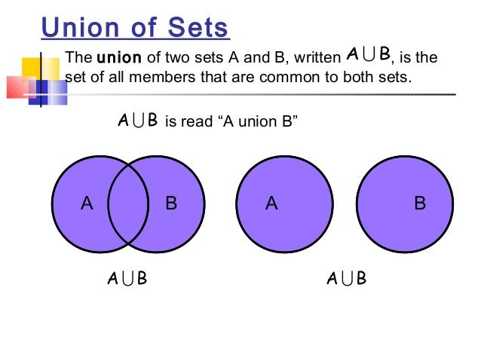
Union
When you take the union of two sets A & B, you come to include any elements in A or B
A ∪ B = {x : x ∈ A or x ∈ B}
Example: let A ⊆ ℕ (A is some subset of the natural numbers)
A ∪ ℕ = ℕ
A ∪ ℝ = ℝ
A ∪ ∅ = A

Slide 6

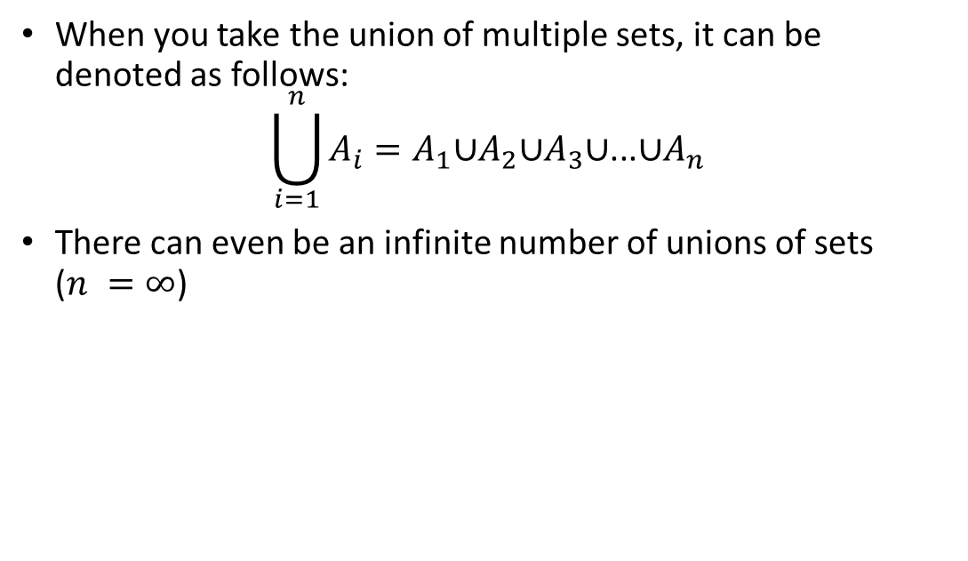
General case of union
When you take the union of multiple sets, it can be denoted as follows:
$$\bigcup_{i=1}^{n}{A_{i}}=A_{1}\text{∪}A_{2}\text{∪}A_{3}\text{∪}\text{...}\text{∪}A_{n}$$
There can even be an infinite number of unions of sets ($n =∞$)

Slide 7
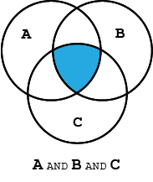
Intersection
When you take the intersection of two sets A & B, you come to include any elements in A and B
A ∩ B = {x : x ∈ A and x ∈ B}
A ∩ ℝ = A
A ∩ ∅ = ∅
Example: let A ⊆ ℕ (A is some subset of the natural numbers)
A ∩ ℕ = A

Slide 8


General case of intersection
When you take the intersection of multiple sets, it can be denoted as follows:
$$\bigcap_{i=1}^{n}{A_{i}}=A_{1}\text{∩}A_{2}\text{∩}A_{3}\text{∩...∩}A_{n}$$
There can even be an infinite number of intersections of sets ($n =∞$)

Slide 9
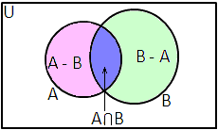

Differences
When you take the difference of two sets A & B, you come to include any elements in A which are not in B
A \ B = {x ∈ A : x ∉ B}
Example: let A ⊆ ℕ (A is some subset of the natural numbers)
A \ ℕ = ∅
A \ ℝ = ∅
A \ ∅ = A
A \ A = ∅
NOTE: the difference is also called relative complements, which shouldn’t be confused with absolute complements.

Slide 10
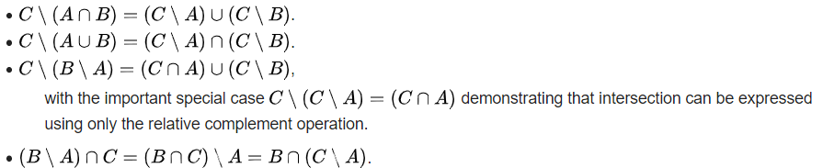
Important properties of difference
Let A, B, and C be three sets. The following identities capture notable properties of relative complements:

Slide 11

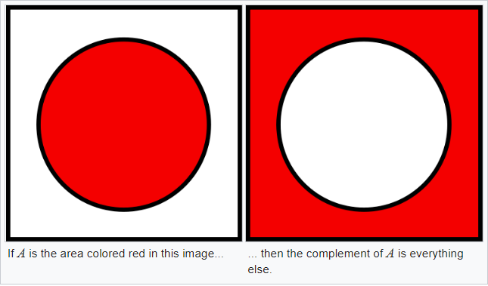
Complements of sets
When considering a set, generally we assign a “universe” 𝕌
The $𝕌$ is the collection of all entities we consider in any given situation
The 𝕌 is the collection of all entities we consider in any given situation
When taking the (absolute) complement of a set, we come to include all elements not in the set
$$A^{c}=\{x ∈ U : x ∉ A\}$$
𝐴^𝑐={𝑥 ∈ 𝑈 : 𝑥 ∉ 𝐴}

Slide 12
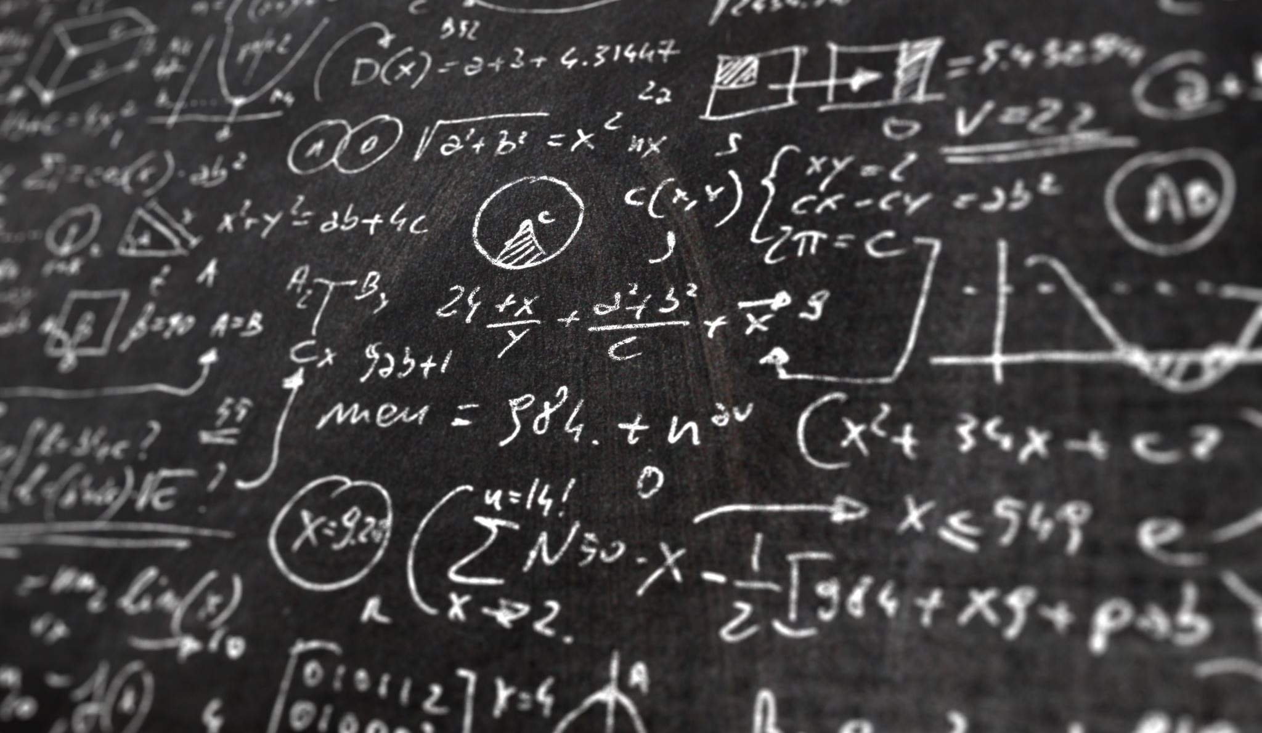
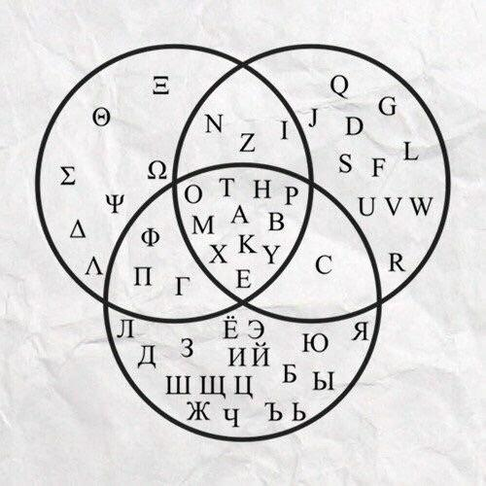
Special Topic: Alphabets, Words and Languages

Slide 13


Alphabets, Words and Languages
An alphabet ($Σ$) is a collection of letters (like {a,b,c,…,x,y,z}) which are used to form words or strings ($Σ^{∗}$)
The most basic form of machines, called deterministic finite state automata (DFA), respond to certain words built in an alphabet. These words are elements of a language (L)

Slide 14
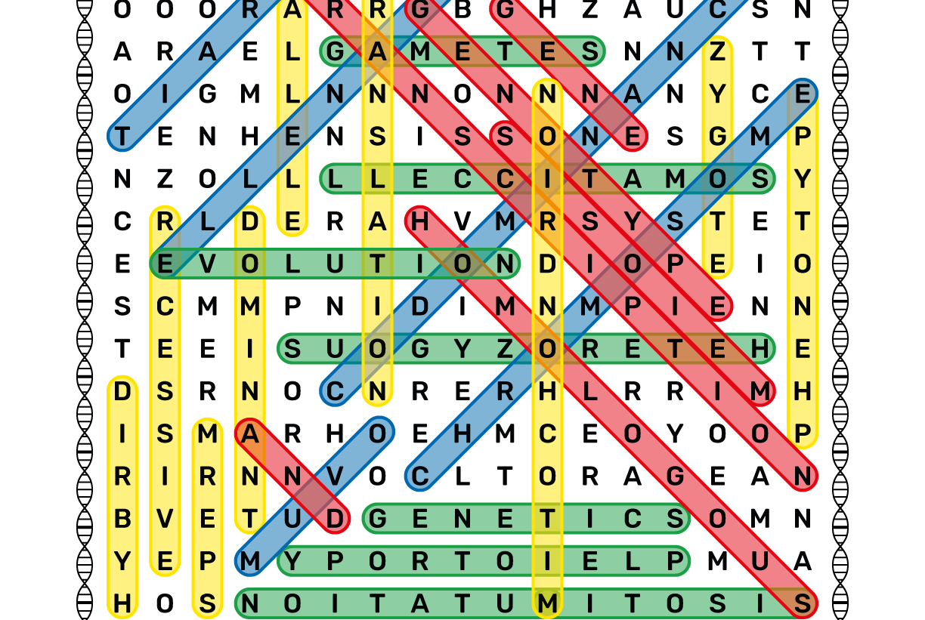
Example

Slide 15

Example: The Soda Machine
Let's take a simple soda machine. If you feed it 35 cents, you get a soda. It would be described as follows:

Slide 16
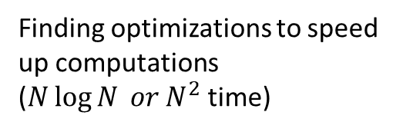
An overview:
Brains and Minds vs Machines
???
Computability Theory
Complexity Theory
Analysis of Algorithms
Formal Language Theory
Harder problems, that could take years to compute
These problems can’t be solved by computers
Finding optimizations to speed up computations ($N\log{N} or N^{2}$ time)
Easily computable like adding up values

